Slide 1


Spin-based Neuromorphic Computing (Simulation)
Presented by: CHONG TIAN EN
Supervised by: S.N. Piramananyagam
Associate Professor
Division of PAP, SPMS
Co-supervised by: Mohamed M. Sabry
Assistant Professor
SCSE
5
th
May 2020

Slide 2


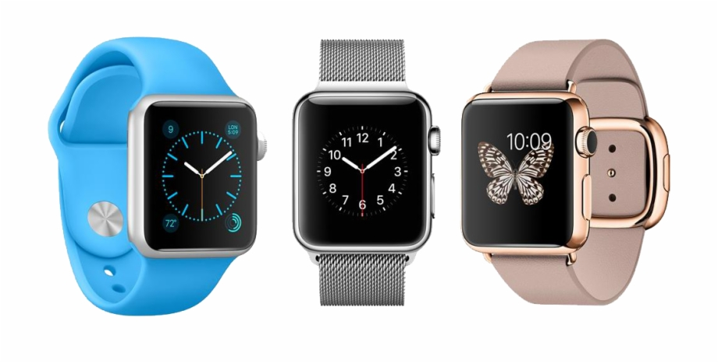

Computing Devices
Performance gained by scaling current semiconductor technologies will hit limit within 10-15 years.
All based on von Neumann Architecture
National Research Council, Enhancing Productivity Growth in the Information Age, 91 (2007)

Slide 3
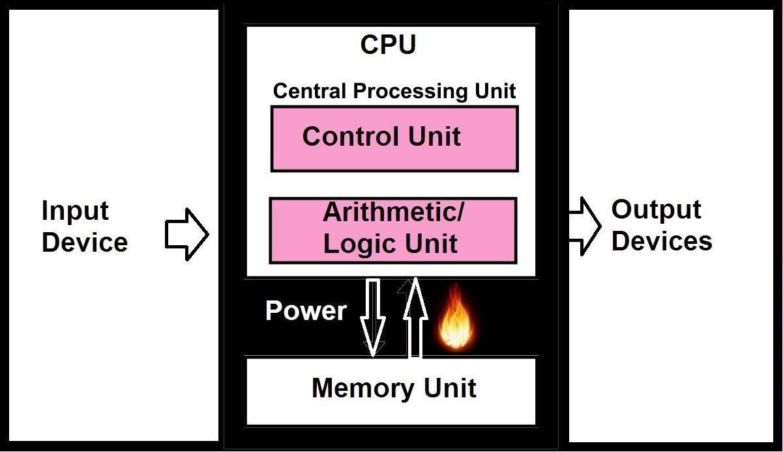
von Neumann Architecture
Memory unit is situated very far from CPU
Frequent data transfer between CPU and Memory Unit consumes more energy and time than actual computation
D. Thompson, “Beyond Von Neumann: Moore’s Law and the Shift from Near-Memory to In-Memory Compute”, (2019)

Slide 4

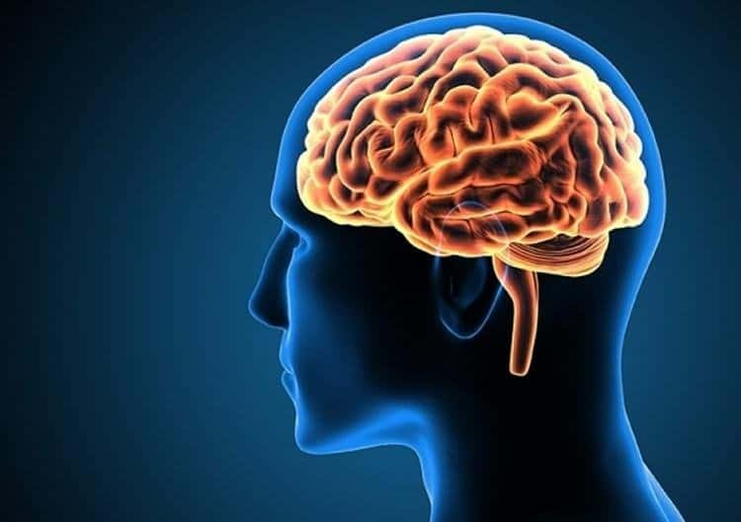
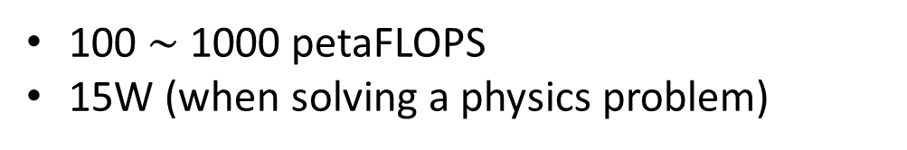
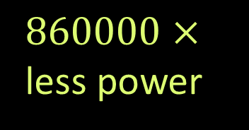

Processing Speed vs Power Consumption
$50\sim 500×$ more performance
$860000×$ less power
2 petaFLOPS
13MW
100 $\sim$ 1000 petaFLOPS
15W (when solving a physics problem)
https://www.olcf.ornl.gov/olcf-resources/compute-systems/summit/
“Brains greatly exceed digital computers in computation per volume per watt”, http://webhome.phy.duke.edu/~hsg/414/images/brain-vs-computer.html

Slide 5
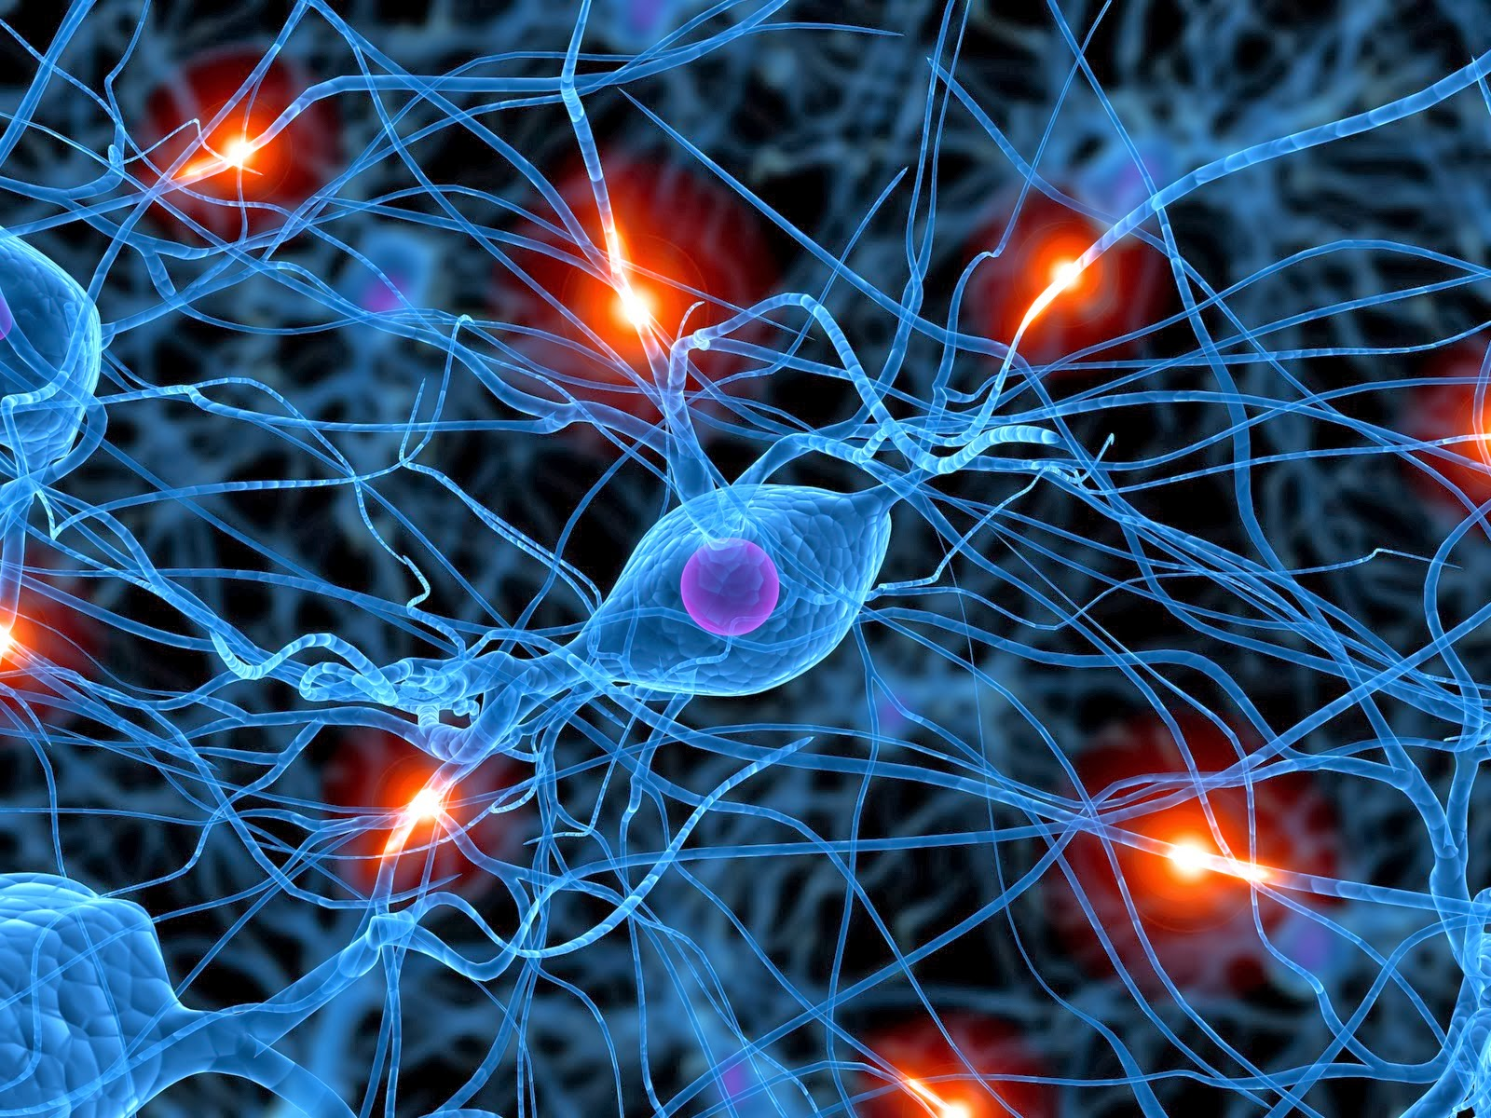
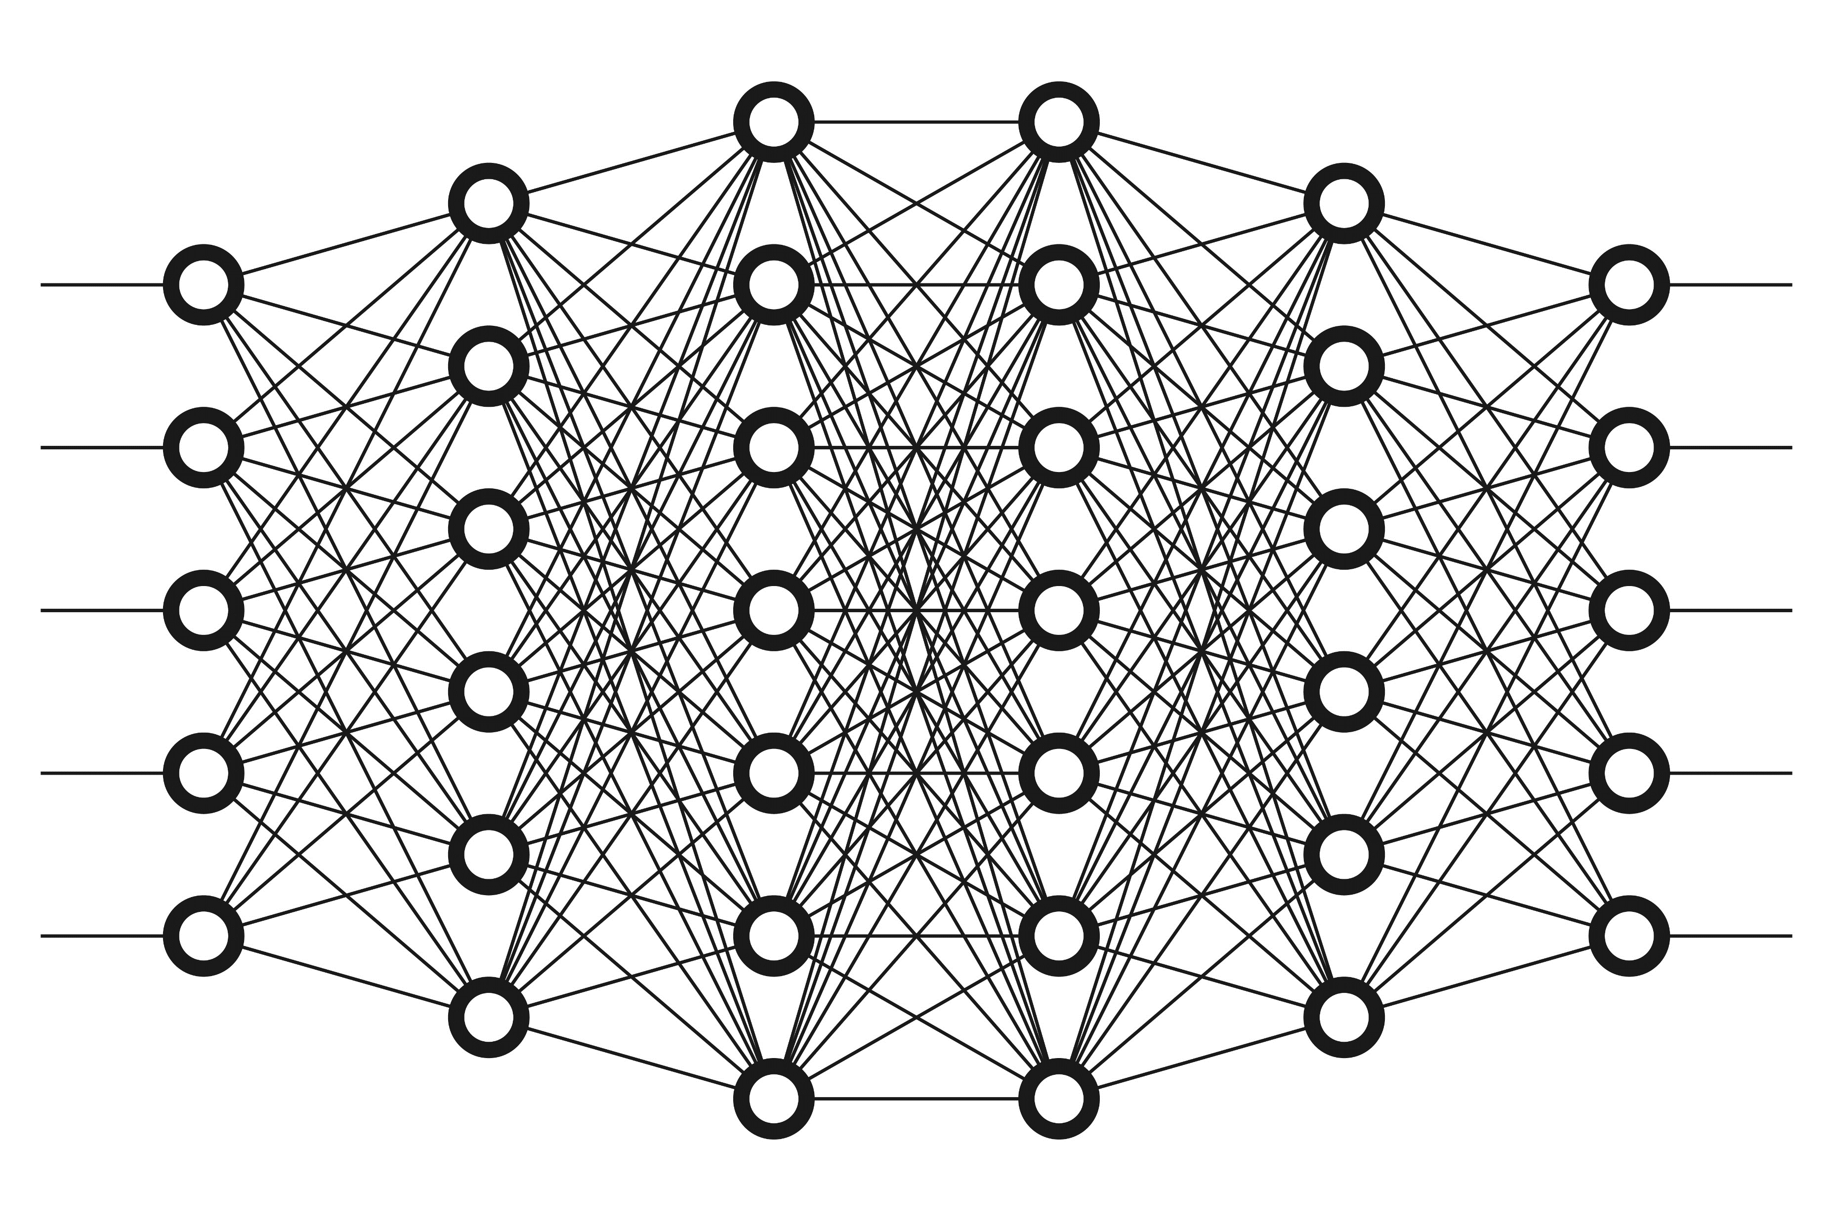
Introduction
Biological Neural Network
Artificial Neural Network
Notes:
Mimic human brain neuron and synapse network
Scope of project: not micromagnetic, but electronic neuromorphic circuit simulation

Slide 6
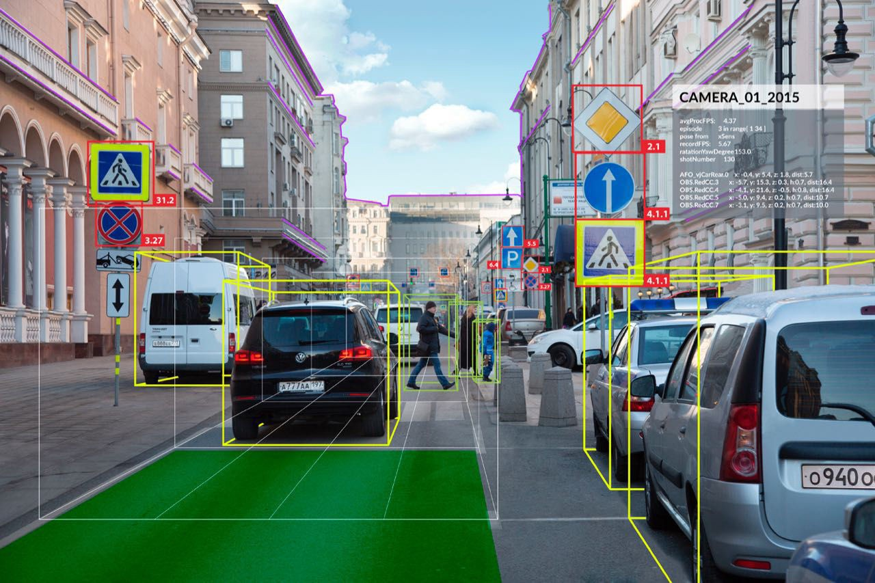
Introduction
Artificial Neural Network
Huge application in AI Computer Vision
Notes:
Scope of project: not micromagnetic, but electronic neuromorphic circuit simulation

Slide 7
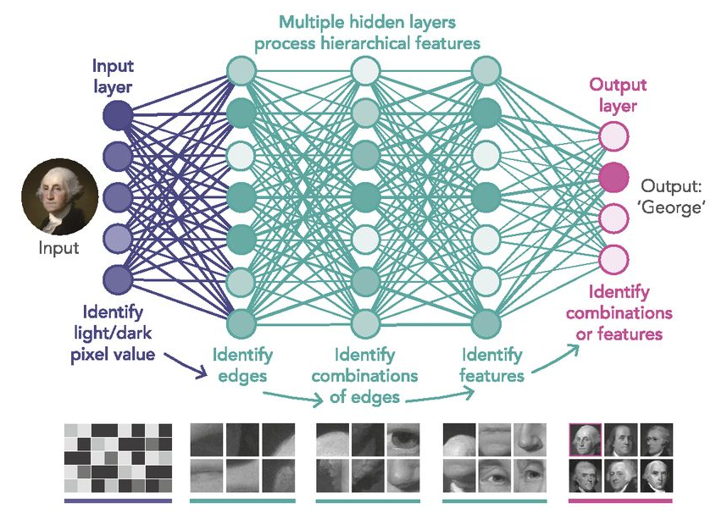
Introduction
Artificial Neural Network
Deeper layer network can extract subtler visual details
M. Mitchell Waldrop, PNAS January 22, 2019 116 (4) 1074-1077
Notes:
Scope of project: not micromagnetic, but electronic neuromorphic circuit simulation

Slide 8

Introduction
1
0
0
0
0
0
0
0
0
1
0
0
1
0
0
0
0
0
1
0
0
1
0
0
0
Handbag
Truck
Traffic Light
Person
Bus
Artificial Neural Network
Network output can be fed for efficient visual object recognition
Notes:
Scope of project: not micromagnetic, but electronic neuromorphic circuit simulation

Slide 9
Introduction
Artificial Neural Network
Implemented in von Neumann Architecture
Notes:
Scope of project: not micromagnetic, but electronic neuromorphic circuit simulation

Slide 10
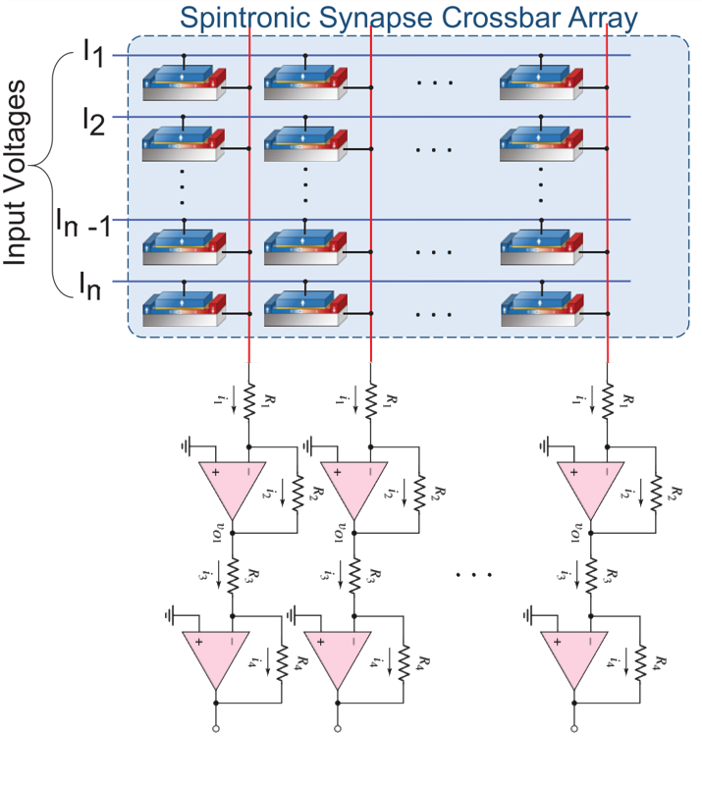
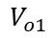
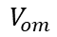
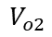
Introduction
Neuron row
$$V_{o1}$$
$$V_{o2}$$
$$V_{om}$$
Artificial Neural Network
Neuron Outputs
Neuromorphic Computing Circuit
Adapted from: A. Sengupta and K. Roy APPLIED PHYSICS REVIEWS 4, 041105 (2017)
Notes:
Scope of project: not micromagnetic, but electronic neuromorphic circuit simulation

Slide 11
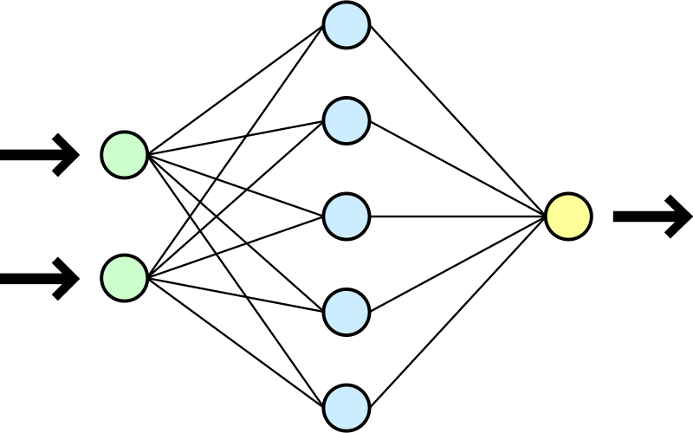
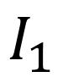
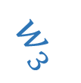
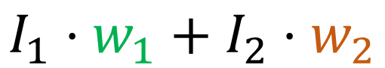
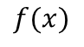
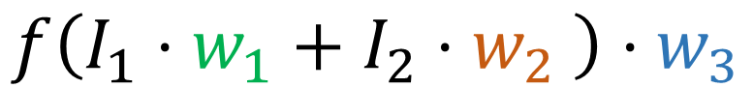

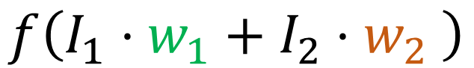

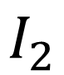
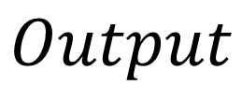
Artificial Neural Network (ANN)
$$I_{1}⋅w_{1}+I_{2}⋅w_{2}$$
$$f\left(I_{1}⋅w_{1}+I_{2}⋅w_{2} \right)$$
$$f(x)$$
$$w_{1}$$
$$w_{2}$$
$$w_{3}$$
$$f\left(I_{1}⋅w_{1}+I_{2}⋅w_{2} \right)⋅w_{3}$$
$$I_{1}$$
$$Output$$
$$I_{2}$$
Notes:
Scope of project: not micromagnetic, but electronic neuromorphic circuit simulation

Slide 12



Artificial Neural Network (ANN)
Involves:
Tensorflow (Machine Learning Platform)
Keras (Python Deep Learning Library)
OpenCV (Computer vision and machine learning library)

Slide 13
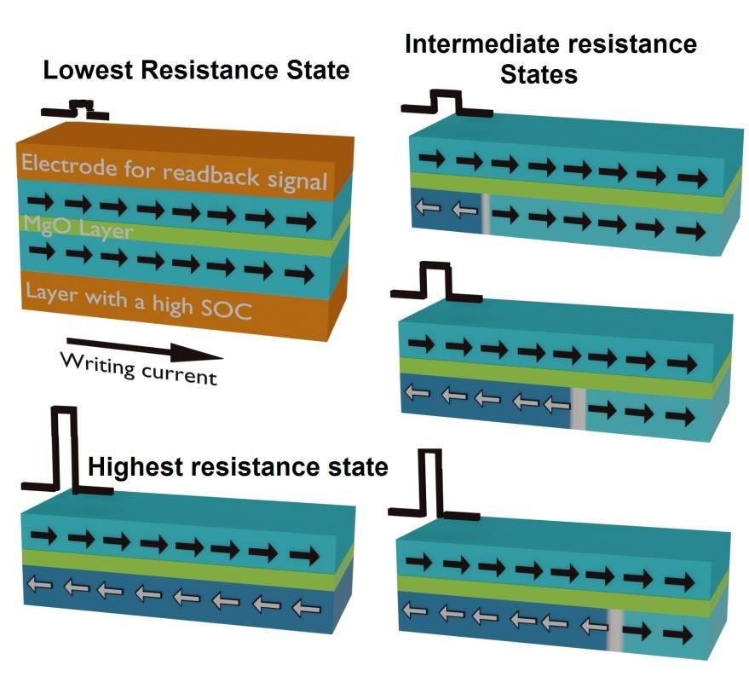
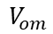
Introduction
A neuron
Neuron row
$$V_{o1}$$
$$V_{o2}$$
$$V_{om}$$
Artificial Neural Network
Neuron Outputs
Neuromorphic Computing Circuit
Notes:
Scope of project: not micromagnetic, but electronic neuromorphic circuit simulation

Slide 14
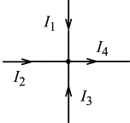
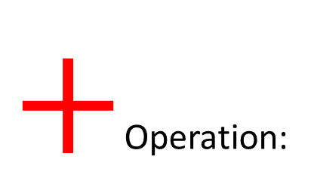
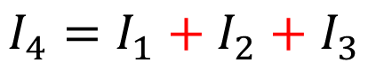
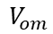
Neuromorphic Computing Circuit
$+$Operation:
Neuron row
$$I_{4}=I_{1}+I_{2}+I_{3}$$
$$V_{o1}$$
$$V_{o2}$$
$$V_{om}$$
Use Kirchhoff’s Current Law for simultaneous summation, not von Neumann CPU that sums one by one
Neuron Outputs
Neuromorphic Computing Circuit
Notes:
Scope of project: not micromagnetic, but electronic neuromorphic circuit simulation

Slide 15
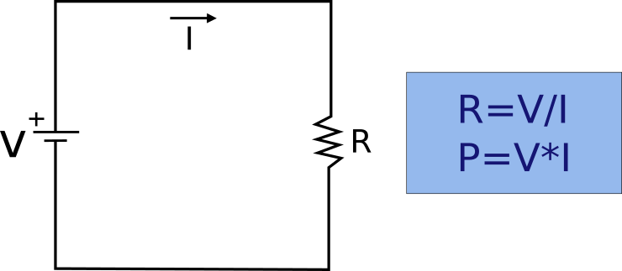
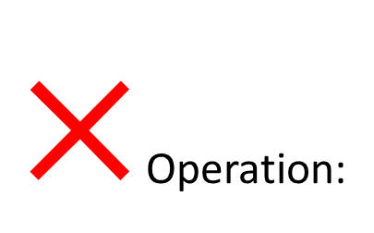
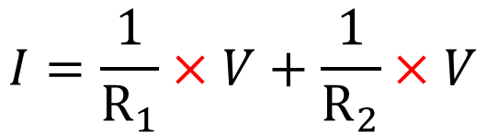
Neuromorphic Computing Circuit
$×$Operation:
1
2
Neuron row
$$I=\frac{1}{R_{1}}×V+\frac{1}{R_{2}}×V$$
$$V_{o1}$$
$$V_{o2}$$
$$V_{om}$$
Neuron Outputs
Use Ohm’s Law for simultaneous multiplication, not von Neumann CPU that multiplies one by one
Neuromorphic Computing Circuit
Notes:
Scope of project: not micromagnetic, but electronic neuromorphic circuit simulation

Slide 16

Neuromorphic Computing Circuit
Memory:
Neuron row
$$w_{1}$$
$$V_{o1}$$
$$V_{o2}$$
$$V_{om}$$
Neuron Outputs
Synapse→ Resistor → Spintronic domain wall device
Neuromorphic Computing Circuit
Notes:
Scope of project: not micromagnetic, but electronic neuromorphic circuit simulation

Slide 17
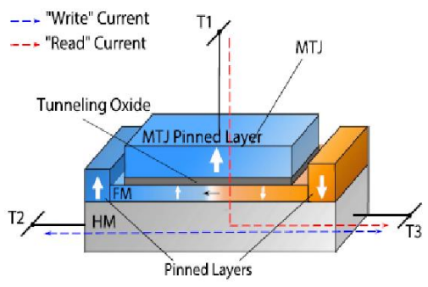
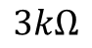
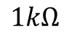
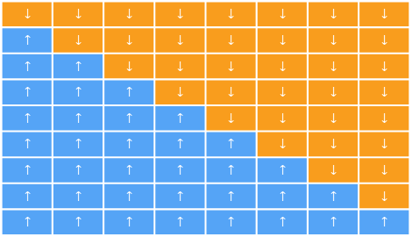
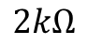
Spintronics as Memory
STT
Involve in:
Spin Transfer Torque (STT) for reading
Spin Orbit Torque (SOT) for writing
Note:
This project only simulates electronic circuit (with MRAM 8-step resistance range), not micromagnetic scope physics.
SOT
$$↑$$ | $$↑$$ | $$↑$$ | $$↑$$ | $$↑$$ | $$↑$$ | $$↑$$ | $$↑$$
Pinned Layer
$$3kΩ$$
$$↓$$ | $$↓$$ | $$↓$$ | $$↓$$ | $$↓$$ | $$↓$$ | $$↓$$ | $$↓$$
$$↑$$ | $$↓$$ | $$↓$$ | $$↓$$ | $$↓$$ | $$↓$$ | $$↓$$ | $$↓$$
$$↑$$ | $$↑$$ | $$↓$$ | $$↓$$ | $$↓$$ | $$↓$$ | $$↓$$ | $$↓$$
$$↑$$ | $$↑$$ | $$↑$$ | $$↓$$ | $$↓$$ | $$↓$$ | $$↓$$ | $$↓$$
$$↑$$ | $$↑$$ | $$↑$$ | $$↑$$ | $$↓$$ | $$↓$$ | $$↓$$ | $$↓$$
$$↑$$ | $$↑$$ | $$↑$$ | $$↑$$ | $$↑$$ | $$↓$$ | $$↓$$ | $$↓$$
$$↑$$ | $$↑$$ | $$↑$$ | $$↑$$ | $$↑$$ | $$↑$$ | $$↓$$ | $$↓$$
$$↑$$ | $$↑$$ | $$↑$$ | $$↑$$ | $$↑$$ | $$↑$$ | $$↑$$ | $$↓$$
$$↑$$ | $$↑$$ | $$↑$$ | $$↑$$ | $$↑$$ | $$↑$$ | $$↑$$ | $$↑$$
$$2kΩ$$
Free Layer
$$1kΩ$$
8-step, 9-level Domain Wall MRAM
A. Sengupta and K. Roy APPLIED PHYSICS REVIEWS 4, 041105 (2017)

Slide 18

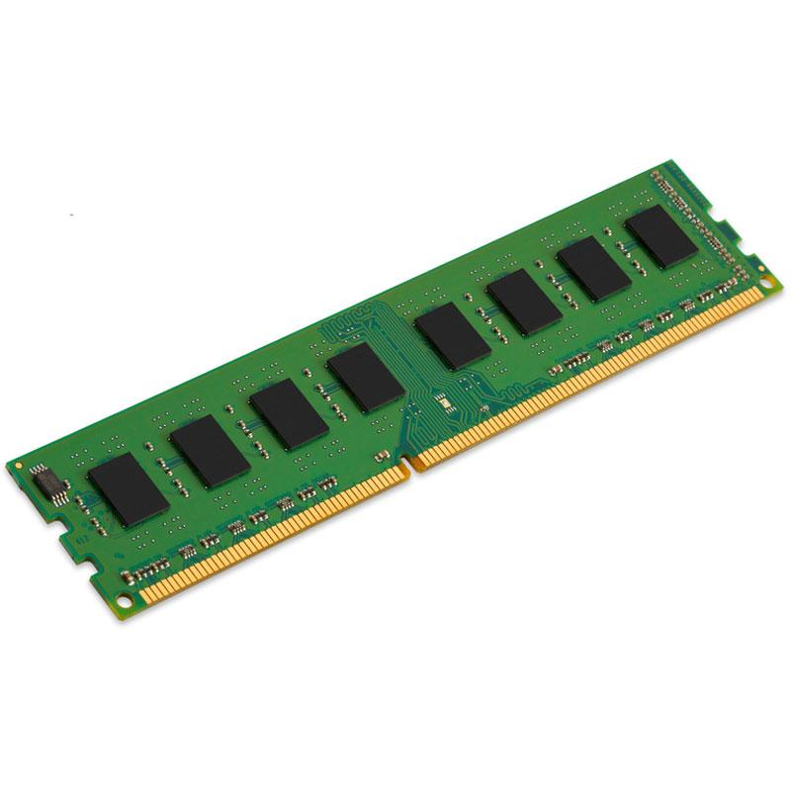
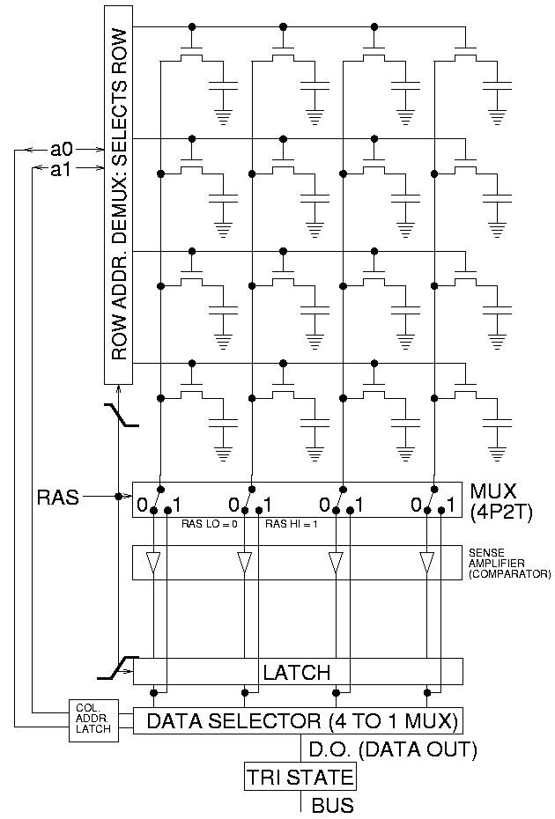
Spintronics as Memory
Solid State Drive (SSD)
Computer DRAM Module and Circuit Diagram
Non-volatile (information retention during power loss) like Solid State Drive (SSD) unlike Metal Oxide Semiconductor (MOS) and leaky Capacitors in DRAM
“DRAM Operation: how does dynamic RAM work”, electronic-notes

Slide 19
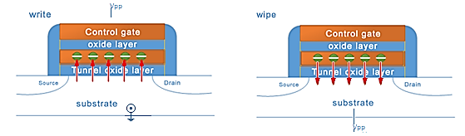
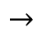
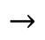
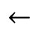
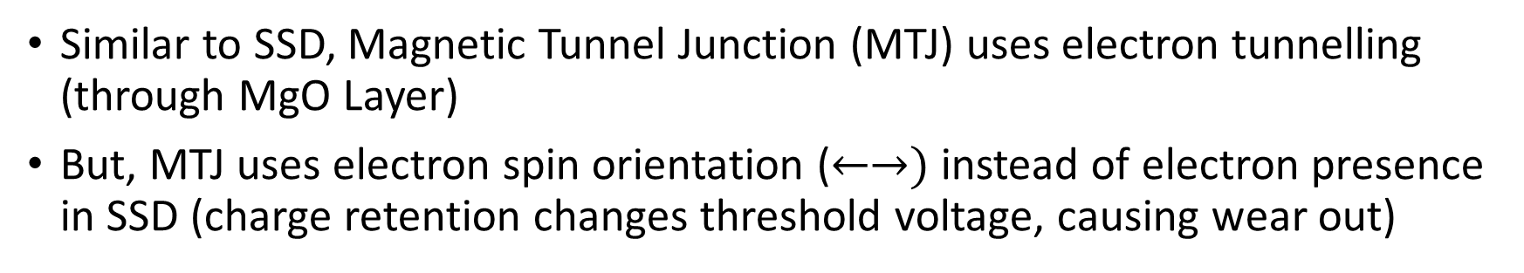
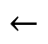
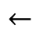
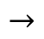
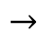
Spintronics as Memory
$$←$$
Some charge stuck here even after wiping
$$→$$
$$←$$
$$→$$
$$→$$
$$←$$
$$→$$
Similar to SSD, Magnetic Tunnel Junction (MTJ) uses electron tunnelling (through MgO Layer)
But, MTJ uses electron spin orientation ($←→)$ instead of electron presence in SSD (charge retention changes threshold voltage, causing wear out)
Jacquelyn, The physical structure of flash memory, ELINFOR (2018)

Slide 20
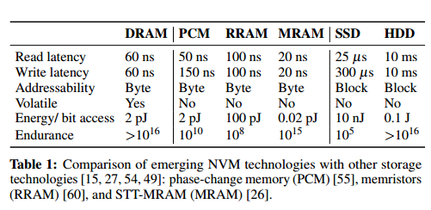
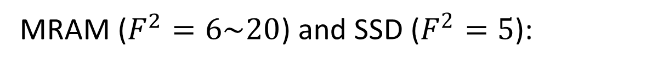
Spintronics Memory Advantage vs Conventional SSD
MRAM ($F^{2}=6\sim 20$) and SSD ($F^{2}=5$):
Higher read/write speed
Lower power
Data does not degrade overtime
S. A. Wolf et al., "The Promise of Nanomagnetics and Spintronics for Future Logic and Universal Memory,“, Proceedings of the IEEE, 98 (12), 2155-2168 (2010).
J. Arulraj et al., “Let’s Talk About Storage & Recovery Methods for Non-Volatile Memory Database Systems ”

Slide 21
Neuromorphic Computing Circuit
In short:
Hardware based implementation of neural network
Application-Specific Integrated Circuit (ASIC)
Not for General Purpose Computing (Forget YouTube, Email, … etc)
Neuron row
Only on von Neumann Architecture
$$V_{o1}$$
$$V_{o2}$$
$$V_{om}$$
Neuron Outputs
Neuromorphic Computing Circuit
Notes:
Scope of project: not micromagnetic, but electronic neuromorphic circuit simulation

Slide 22
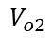


Objective
ANN in TensorFlow
Neuromorphic in Cadence
VS
Neuron row
$$V_{o1}$$
$$V_{o2}$$
$$V_{om}$$
Neuron Outputs
To create and simulate model of practical, manufacturable (non-ideal) neuromorphic network, incorporated with 8-step domain wall MRAM resistance range based synapses
To compare the performance between traditional software (Tensorflow) implemented neural network (ANN) and (Cadence) neuromorphic model .

Slide 23
Simulation Details (Outline)
Theory:
Inverting Summing Operational Amplifier (OpAmp)
Synaptic Weight
Weight→Resistance
Matrix Implementation
Actual Simulation Environment:
Cadence Development Environment with 65nm Process Design Kit (PDK)
Code Files
Programmable Scalable Network (Generated)

Slide 24






Inverting Summing OpAmp
0V
$$R_{1}$$
$$R_{2}$$
$$R_{3}$$
Ideally,
$$V_{out}={−R}_{F}\left(\frac{1}{R_{1}}V_{1}+\frac{1}{R_{2}}V_{2}+\frac{1}{R_{3}}V_{3}\right)$$
Note $R_{F}$ & $R_{in}$ should be:
As high as possible to reduce power consumption
Scale with number of incoming source
Too low $R_{F}$ & $R_{in}$ cause the ideal relationship above break down due to non-zero virtual ground voltage

Slide 25

Tuned 741 Texas Instrument OpAmp Model

Slide 26










Synaptic Weight
n = 3
$$V_{o1}$$
$$V_{i1}$$
$$w_{11}$$ | $$w_{21}$$ | $$w_{31}$$
$$w_{12}$$ | $$w_{22}$$ | $$w_{32}$$
$$w_{13}$$ | $$w_{23}$$ | $$w_{33}$$
$$w_{14}$$ | $$w_{24}$$ | $$w_{34}$$
$$V_{o2}$$
$$V_{i2}$$
m = 4
$$V_{o3}$$
$$V_{i3}$$
$$V_{o4}$$
Note:
$w_{ab}$ means weight from node $a$ to node $b$
$0<w_{ab}≤1$

Slide 27

Weight $→$ Resistance
$$\left(\begin{matrix}w_{11} & w_{21} & w_{31} \\ w_{12} & w_{22} & w_{32} \\ w_{13} & w_{23} & w_{33} \\ w_{14} & w_{24} & w_{34}\end{matrix}\right)→\left(\begin{matrix}{1/R}_{11} & {1/R}_{21} & {1/R}_{31} \\ {1/R}_{12} & {1/R}_{22} & {1/R}_{32} \\ {1/R}_{13} & {1/R}_{23} & {1/R}_{33} \\ {1/R}_{14} & {1/R}_{24} & {1/R}_{34}\end{matrix}\right)$$
$$R=1/w$$

Slide 28

Matrix Implementation
$$\left[\begin{matrix}V_{o1} \\ V_{o2} \\ V_{o3} \\ V_{o4}\end{matrix}\right]=−R_{F}\left[\begin{matrix}1/{R_{F}} & 0 & 0 & 0 \\ 0 & 1/{R_{F}} & 0 & 0 \\ 0 & 0 & 1/{R_{F}} & 0 \\ 0 & 0 & 0 & 1/{R_{F}}\end{matrix}\right]\left(−R_{F}\left[\begin{matrix}1/{R_{11}\left|R_{F}\right|} & 1/{R_{21}\left|R_{F}\right|} & 1/{R_{31}\left|R_{F}\right|} \\ 1/{R_{12}\left|R_{F}\right|} & 1/{R_{22}\left|R_{F}\right|} & 1/{R_{32}\left|R_{F}\right|} \\ 1/{R_{13}\left|R_{F}\right|} & 1/{R_{23}\left|R_{F}\right|} & 1/{R_{33}\left|R_{F}\right|} \\ 1/{R_{14}\left|R_{F}\right|} & 1/{R_{24}\left|R_{F}\right|} & 1/{R_{34}\left|R_{F}\right|}\end{matrix}\right]\right)\left[\begin{matrix}V_{i1} \\ V_{i2} \\ V_{i3}\end{matrix}\right]$$

Slide 29

Cadence Development Environment with 65nm PDK

Slide 30

Code Files
SKILL file (generates scalable circuit design) – scaled.il
OCEAN file (automates simulation process) – vlsim.ocn
PYTHON file (generates data files v_arr & r_arr) – initvar.py
Data files
v_arr (set $V_{in}$)
r_arr (set $R_{nm}$)
sumVlsiSetup (set $n,m,R_{F}$ values)

Slide 31

Programmable Scalable Network (Generated)
m
n
m
4 by 4 synapses
4 neurons
n

Slide 32

Programmable Scalable Network (Generated)
40 by 40 synapses, 40 neurons

Slide 33

Pre-Simulation Result (Outline)
Choice of switch (NMOS? PMOS?)
20 by n synapses without switch to find $R_{F}$ (All same $R_{F}$)
20 by 784 synapses with switch & synapses (8-step 1k$Ω$ to 3k$Ω$) and all different $R_{F}$ (1326000$Ω$, 50000$Ω$, 281690$Ω$) to tune accuracy for:
Normal power case
Extreme power case

Slide 34


Choice of MOS switch (NMOS? PMOS?)
For $n=10$, $m=20$, $R_{F}=50000Ω$:
NMOS
PMOS
✓
Closeness (simulated/ideal in %) | 80.305877
S.D. (%) | 3.034855
Closeness (simulated/ideal in %) | 67.714079
S.D. (%) | 3.941705

Slide 35


20 by n synapses without switches (determine $R_{F}$)
Note:
Good $R_{F}$ value means close to 100% with low error.
$R$ here means $R_{F}$.

Slide 36

20 by 784 Synapses with switch & 8-step R (Normal)

Slide 37




20 by 784 Synapses with switch & 8-step R (Ex)
(All low R, high power consumption), same $R_{F}$, same random $V_{in}$
Simulated (V) | Ideal (V)
2.766582 | 4.973581
$\text{Closeness}$(simulated/ideal in %) | 55.625561
All R = 1000$Ω$
$$↑$$ | $$↑$$ | $$↑$$ | $$↑$$ | $$↑$$ | $$↑$$ | $$↑$$ | $$↑$$
Pinned Layer
$$↑$$ | $$↑$$ | $$↑$$ | $$↑$$ | $$↑$$ | $$↑$$ | $$↑$$ | $$↑$$
Free Layer
(All high R, low power consumption), same $R_{F}$, same random $V_{in}$
Simulated (V) | Ideal (V)
2.653436 | 1.617143
$\text{Closeness}$(simulated/ideal in %) | 164.081739
All R = 3000$Ω$
$$↑$$ | $$↑$$ | $$↑$$ | $$↑$$ | $$↑$$ | $$↑$$ | $$↑$$ | $$↑$$
Pinned Layer
$$↓$$ | $$↓$$ | $$↓$$ | $$↓$$ | $$↓$$ | $$↓$$ | $$↓$$ | $$↓$$
Free Layer
Notes:
Nebi Caka
Professor at University of Prishtina, Faculty of Electrical and Computer Engineering
In a semiconductor the mobility of electrons (referring to ‘conduction electrons’ or ‘free-electrons’) is greater than that of a holes (indirectly referring to ‘valence electrons’) because of different band structure and scattering mechanisms of these two carrier types.
Conduction electrons (free-electrons) travel in the conduction band and valence electrons (holes) travel in the valence band. In an applied electric field, valence electrons cannot move as freely as the free electrons because their movement is restricted. The mobility of a particle in a semiconductor is larger if its effective mass is smaller and the time between scattering events is larger.
Holes are created by the elevation of electrons from innermost shells to higher shells or shells with higher energy levels. Since holes are subjected to the stronger atomic force pulled by the nucleus than the electrons residing in the higher shells or farther shells, holes have a lower mobility.
In an intrinsic silicon, at temperature 300 K:
Electron mobility = 1500 cm2/(V∙s)
Hole mobility = 475 cm2/(V∙s)

Slide 38

Case Study - MNIST
MNIST (Standard Handwritten Digit Dataset)

Slide 39
MNIST General Simulation Steps (Outline)
Explore ANN architectural layer types
Discover ANN Weights and MRAM Resistance Relationship
Explore weight processing function to maintain previous relationship
Train different MNIST architectures/model (pick best one and transfer to neuromorphic circuit, … and voila!)

Slide 40


MNIST ANN Preliminary Simulation Result
Output
Input -> FCN 100 -> output
Accuracy : 11.78%
Input -> FCN 100 (ReLU) -> output
Accuracy : 11.35%
Input -> FCN 100 (ReLU) -> output (ReLU)
Accuracy : 9.80%
Input -> FCN 100 (ReLU) -> output (Softmax)
Accuracy : 96.91%
Input -> FCN 100 (Softmax) -> output (Softmax)
Accuracy : 54.97%
Input
Output
Input

Slide 41


ANN Architecture Layer Introduction
5 Fully Connected Layer (5 FCN)
1 Convolution Layer (1 Conv)
1 Maxpooling Layer (Maxpool)
1
2
3
4
5
“Starting with convolutional neural network (CNN)”, datascienceplus (2019)
“Deep Convolutional Neural Networks an Introduction”, mbenhaddou.com (2019)

Slide 42


ANN Weight and MRAM Resistance Relationship
Physical R ($Ω$) | R (Ω) | Comp. w | Decomp. w
1000 | 1.0 | 1.0 | 1.0
1250 | 1.25 | 0.8 | 0.7000
1500 | 1.5 | 0.6667 | 0.4999
1750 | 1.75 | 0.5714 | 0.3571
2000 | 2.0 | 0.5 | 0.25
2250 | 2.25 | 0.4444 | 0.1667
2500 | 2.5 | 0.4 | 0.1000
2750 | 2.75 | 0.3636 | 0.0454
3000 | 3.0 | 0.3333 | 0
TensorFlow weight constraint $0≤w_{decompressed}≤1$

Slide 43

ANN Weight Processing - CompDecomp
ComDecomp - MRAM non uniform 8-step rounding, lossless compression and decompression (no weight clipping at boundaries)

Slide 44
ANN Weight Processing - Limit
Limit - Continuous scaling (lossy weight clipping at boundaries)

Slide 45
ANN Weight Processing - StepUniform
StepUniform - Uniform n-step scaling (cf. MRAM non-uniform 8-step scaling)

Slide 46

Unprocessed Accuracy
20 FCN
1000 FCN
20 Conv Maxpool 10 FCN
90.20%
92.52%
95.61%
100 Conv Maxpool 10 FCN
(20 Conv Maxpool)$×$2 10 FCN
20 Conv Maxpool 50 Conv Maxpool 10 FCN
96.27%
97.97%
98.14%

Slide 47







CompDecomp Accuracy
20 FCN
1000 FCN
20 Conv Maxpool 10 FCN
80.24%
100 Conv Maxpool 10 FCN
(20 Conv Maxpool)$×$2 10 FCN
20 Conv Maxpool 50 Conv Maxpool 10 FCN

Slide 48






Limit Accuracy
20 FCN
1000 FCN
20 Conv Maxpool 10 FCN
100 Conv Maxpool 10 FCN
(20 Conv Maxpool)$×$2 10 FCN
20 Conv Maxpool 50 Conv Maxpool 10 FCN

Slide 49






StepUniform Accuracy
)
20 FCN
1000 FCN
20 Conv Maxpool 10 FCN
100 Conv Maxpool 10 FCN
(20 Conv Maxpool)$×$2 10 FCN
20 Conv Maxpool 50 Conv Maxpool 10 FCN

Slide 50
MNIST Neuromorphic Circuit Architecture
$20×784$ FCN Layer
20×784 FCN Layer
$10×20$ FCN Layer
10×20 FCN Layer
Input
Final Output
Intermediate Output

Slide 51


Simulation Result (20 by 784 Single Stage Summing)
Average Closeness (%) | 101.02436
S.D. (%) | 54.367929
S.D. = 53.8% (after scaling average to 100%)

Slide 52


Simulation Result (20 by 784 Double Stage Summing)
Average Closeness (%) | 17.794647
S.D. (%) | 9.602465
S.D. = 54.0% (after scaling average to 100%)

Slide 53
MNIST Neuromorphic Circuit Architecture
$20×784$ FCN Layer
20×784 FCN Layer
$10×20$ FCN Layer
10×20 FCN Layer
Input
Final Output
Intermediate Output

Slide 54

MNIST 10 $×$ 20 FCN Neuromorphic Layer
Neuron outputs are measured and Softmax function is applied (not implemented in circuit)

Slide 55

MNIST 10 $×$ 20 FCN Neuromorphic Layer
0.1000 | 0.0981 | 0.0994 | 0.1002 | 0.1000 | 0.0995 | 0.0994 | 0.1029 | 0.0992 | 0.1011
[0] | [1] | [2] | [3] | [4] | [5] | [6] | [7] | [8] | [9]
Location of maximum value is extracted to predict the 10000 MNIST test dataset samples

Slide 56

MNIST Simulation Result (MNIST 10 $×$ 20 FCN)
Accuracy | 81.02%
vs 80.24% (Tensorflow) (Surprisingly better with circuit errors!)

Slide 57

Discussion
Need to retune $R_{F}$ with network of different scale to obtain high closeness (simulated/ideal value in %).
Deeper layer networks bring high ideal accuracy in Tensorflow, but low accuracy for neuromorphic circuit (more errors resulted).
20 Conv Maxpool 50 Conv Maxpool 10 FCN (CompDecomp)
20 Conv Maxpool 50 Conv Maxpool 10 FCN
9.8%
98.14%
Notes:
we need to strike a balance.
MRAM limited 8 steps weights rounding result in reduced accuracy due to not representing weights faithfully, which can be solved with higher steps weight representation.

Slide 58

Discussion
0V
$$V_{out}={−R}_{F}\left(\frac{1}{R_{1}}V_{1}+\frac{1}{R_{2}}V_{2}+\frac{1}{R_{3}}V_{3}\right)$$
Need to scale $R_{F}$ to amplify simulated value to ideal value (virtual ground no longer 0V).

Slide 59

Discussion
0V
$$≈0.4V$$
$$V_{out}={−R}_{F}\left(\frac{1}{R_{1}}V_{1}+\frac{1}{R_{2}}V_{2}+\frac{1}{R_{3}}V_{3}\right)$$
Larger network cause OpAmp virtual ground voltage to stuck at high voltage (ideal equation breaks).

Slide 60
Conclusion
Neuromorphic computing offers high accuracy for off-chip training TensorFlow architecture
Suffers scaling issues due to non-ideal OpAmp behaviour and MRAM limited 8-step weight representation
81.02% for MNIST 10 × 20 FCN

Slide 61
Future Work
Sourcing a higher precision opamp
Creating an opamp that can sustain 0V virtual ground voltage.
Re-simulating large scale end-to-end neuromorphic circuit after overcoming OpAmp limitation.
Implementing and simulating micromagnetic scope domain wall synapse based neuromorphic circuit.

Slide 62

Future Work
Exploring spiked based neural network and its neuromorphic equivalent

Slide 63
Thank you!

